Slide 1
Spa and Salon Booking System
Instructed by Dr .Suchetana Chakraborty

Slide 2
Problem Statement
"We have developed a comprehensive Spa & Salon Booking System with dedicated pages for both stylists and customers. Our system ensures a seamless booking experience, eliminating any scheduling conflicts to provide a smooth and efficient service."

Slide 3
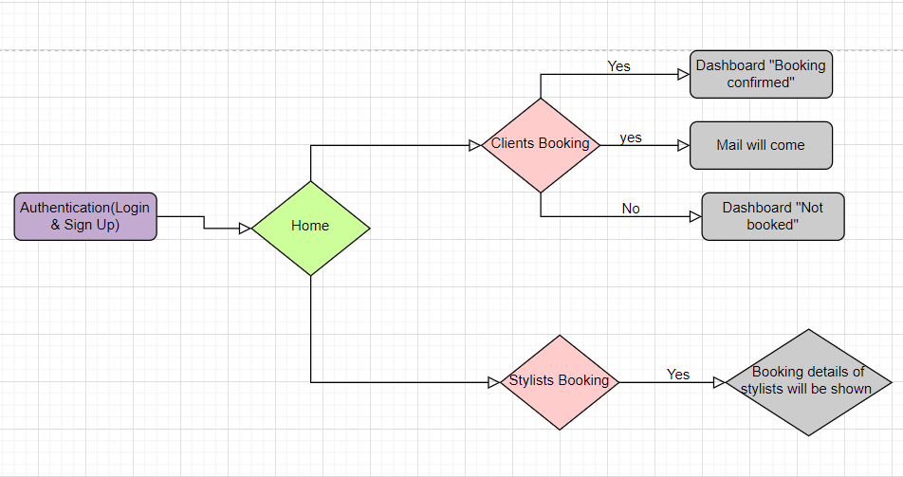
Implementation (Demo)

Slide 4
Novelty(Innovation with Justification)
Key innovations:
No duplicate entries allowed.
Time constraints preventing immediate booking for a similar service.
Slot-specific restrictions (e.g., evening slot restriction after morning booking).
Booking details sent to customer via email.
Justifications:
Prevention of Duplicate Entries : Enhances experience with a streamlined, error-free booking by ensuring data accuracy. Improves efficiency, saving time for customers and staff, eliminating manual error correction in scheduling.
Time Constraints for Similar Services : Prioritizing customer satisfaction, a 45-minute gap between services ensures personalized attention, while optimized resource allocation fosters a balanced, efficient schedule.
Slot-Specific Restrictions : Enhances user experience by offering flexibility, maintaining fairness, and preventing inconveniences. Improves efficiency through optimal resource utilization for a seamless booking process.

Slide 5
Contribution
Oppangi Poojita : Normalization , Hashing , main.py , booking page , edit page. Eslavath Meenakshi : Schemas in sql database , Customer pages, login & Sign Up pages. Keshika Patwari : implemented Clashing part , Stylists Pages, Stylist_booking page , Indexing.

Slide 6
Thank you
Keshika Patwari
Eslavath Meenakshi
Oppangi Poojita

